Slide 1
Maker’s Course Part 3 – Micro controllers
Gil Tal.
Aug 2024

Slide 3
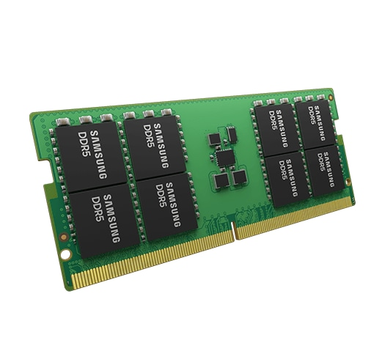

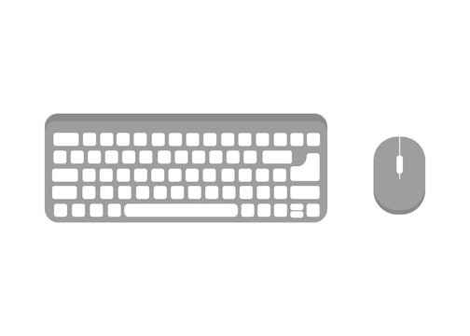
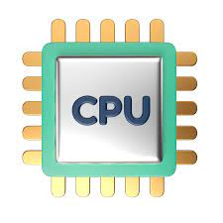
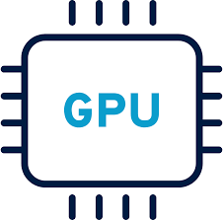
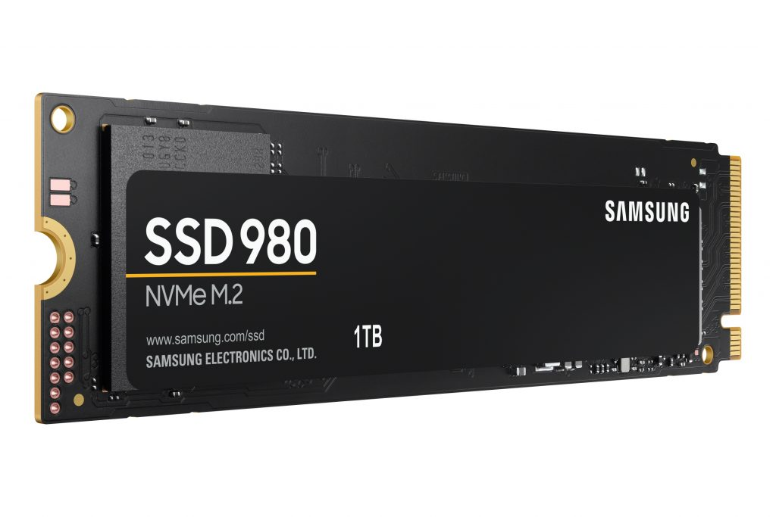
DRAM dedicated protocol
HDMI
USB\BLE
PCIe
PCIe

Slide 4
What is a micro controller?
Basically, it is a system on a chip – meaning …
It has almost all we need to run a computing system in a single chip:
CPU
Dynamic memory (DRAM on our PC)
Nonvolatile memory (HDD\SSD on our PC)
Communication ports (USB\PCIe\Thunderbolt on our PC)
I/O ports
The rest depends on the complexity of the micro controller

Slide 5
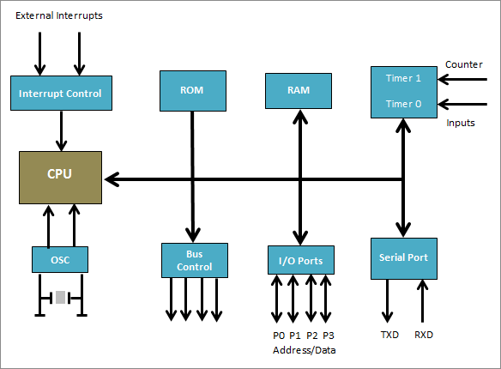
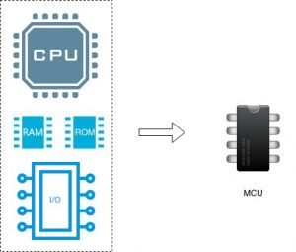
MCU General Block diagram

Slide 6
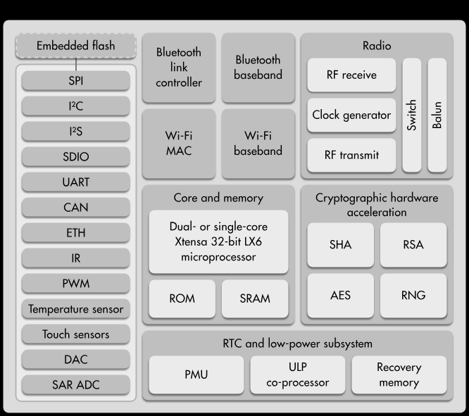
ESP32 block diagram

Slide 7
Communication ports are meant for:
Expanding the capabilities of our MCU
Connection for various devices available on the market
LCD
Micro
Controller
3G modem
SPI/GPIO/I2C
UART
RTC
Clock
Wi-Fi\BLE\LoRa
WiFi\BLE\LoRa
I2C
SPI
Another Micro Controller
PC
Phone
SD Card

Slide 8
Communication protocol properties
Bus topology or point to point
Bandwidth – set by:
Frequency
Width (number of signals used for data)
Operating voltage
Half or full duplex
Power consumption
Data protection support

Slide 9
More about the ESP32
Runs under Arduino’s IDE
Dual 32 bit CPU cores @ 240MHz
Support true multi threading with bounding to specific CPU
512KB of SRAM (extra 8MB through SPI device)
4/16MB of flash memory
EEPROM (4KB)
Full power management control - Deep sleep etc.
CPU 64-bit counter
Native OTA (Over the Air Update)
Native file system (SPIFFS) with very easy way to upload an image
Running FreeRTOS operating system which can be utilized or ignored
Many external interfaces equipped with DMA for accelerated data transfer
Wi-Fi and Bluetooth (BLE) easily accessible
Ultra low power co-processor for extreme power management control

Slide 10
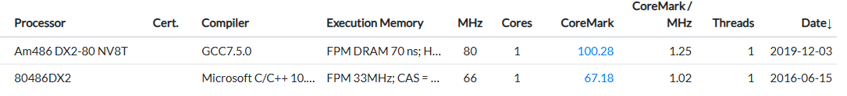
More about the esp32
Has touch sensors
Native PWM
Two DAC (Digital to analog) – Not supported on ESP32-S3 ☹
Many ADC (Analog to digital)
Performance:
ESP32 (LX6) CoreMark: 500 per CPU
ESP32-S3 (LX7) CoreMark: 612 per CPU!

Slide 11
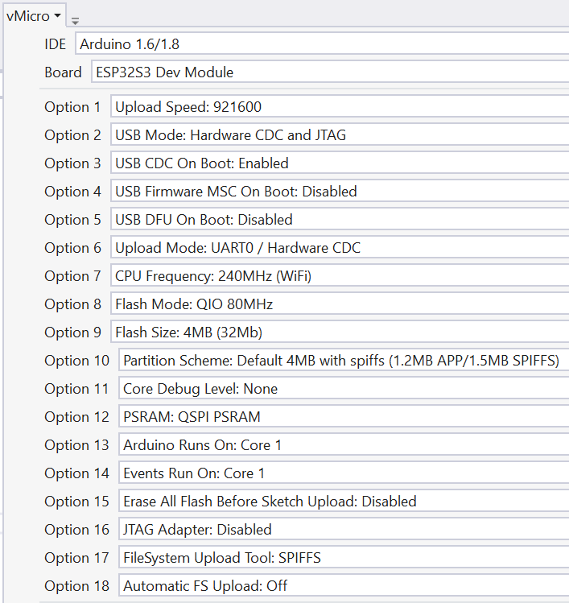
ESP32 memory map (for 4 MB version)
Program code (configurable)
Dynamic RAM
Flash program
Slot 1 (1.3M)
384KB fast SRAM
malloc or new
Flash program
Slot 2 (1.3M)
2-8MB SPI SRAM
ps_malloc
SPI-File System
1.5MB
heap_caps_malloc_extmem_enable(1024 * 1024 * 2);
// Enable malloc and new from PSRAM!

Slide 12
Accessories/peripherals/devices - Properties
Communication protocol voltage level
Voltage supply
Power consumption
Band Width
SW Driver
Interrupt driven or polling
Timing specifications
Setup, hold and the alike
Max frequency (when relevant)
Protocol
Type (UART, SPI, I2C, Etc.)
Sync – meaning using clock (limited frequency) or sync signals
A-Sync
Data assurance\protection using (parity, ECC, CRC etc.)

Slide 13
Basic communication protocols
Devices can be connected physically by copper wires or over the air (Wi-Fi, Bluetooth, LoRa)
There are various communication protocols, some are standard, and some are unique
Simple protocols: (Low to medium speed and bandwidth)
I2C (Two wires – data and clock) (100 or 400 KHz) – Bus topology
UART (RS232) (9600 up to 921000 bps) – Point to point
SPI - Serial Peripheral Interface (1 – 166 MHz (DDR), data width 1 - 8 bits) – Bus topology with chip select
RF (LoRa and more)
Advanced protocols (Medium to very high speed and bandwidth)
Bluetooth
Wi-Fi, Ethernet
PCIe (Gen 1-6 running at 2.5-64GHz 1-16 bits width)
USB2\3\4 (up to 100GHz)
Thunderbolt (up to 100GHz)

Slide 14
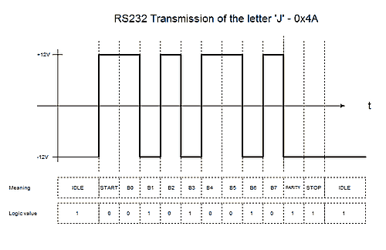
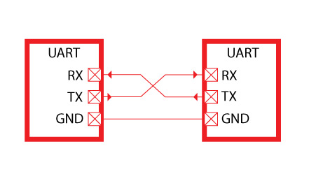
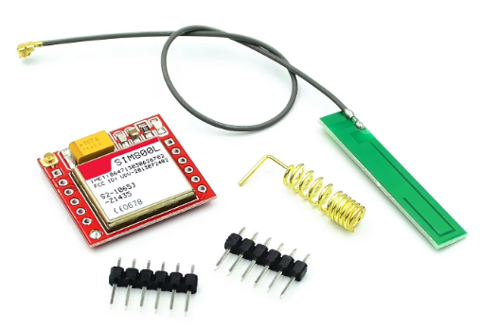
RS232 - UART
Was born in 1960
In the basic mode uses two signals: RX and TX (Receive and Transmit)
Works at speeds from 4800 (bits per second) up to 921000 (usually 115200 is being used)
Both transmitter and receiver must be set at the same baud rate
Works at various voltages (although the standard is +/- 12V)
Used by most of the micro controllers as the main communication port
Today mostly used using USB to UART device (FTDI)

Slide 15
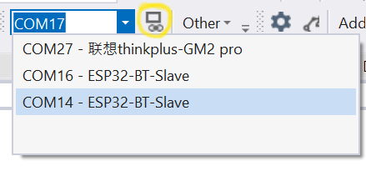
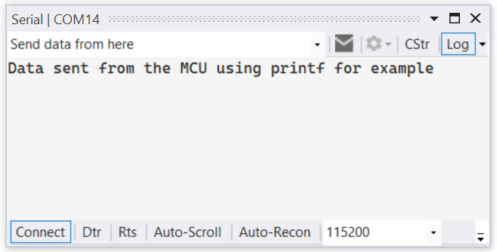
Usage of RS232 on our PC and Arduino
Our PC\Laptop
Our MCU
FTDI
UART to USB
Serial \ UART communication
Application
(COM3 for example)
USB
Port

Slide 16
RS232\UART in our code (ESP32 has 3 units)
void setup()
{
Serial.begin(115200); // Use Serial1 or Serial2 for other UART units
Serial1.begin(115200/*Baud*/, SERIAL_8N1, 4/*RX*/, 2/*TX*/);
}
// This code example writes to the terminal whatever it receives from the UART RX
void loop()
{
while (Serial.available() == 0);
int UARTdataSize = Serial.available();
for (size_t i = 0; i < UARTdataSize; i++)
{
Serial.write(Serial.read());
}
}

Slide 17
End to end example

Slide 18

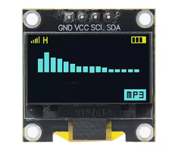
I2C Protocol (Inter-Integrated Circuit)
Defined by Philips for variety of simple devices such as
EEPROM, Cameras, simple LCDs, modems, I/O expanders and more
Each family of devices has a unique address prefix (There are some out of spec devices ☹)
Very low bus speed : 100 – 400 KHz (new devices might support 1 M\bit)
Two signals only: SCL (Clock), SDL (Data)
No chip select, address selectable devices (7 or 10 bit)
Bus topology: meaning many devices can be connected to the same master
Open drain I/O (Must have pull up resistors, usually 4.7K)
Master and slave topology (Only master can initiate a transaction)
Some device has fixed 4-6 address bits and the rest can be set

Slide 19
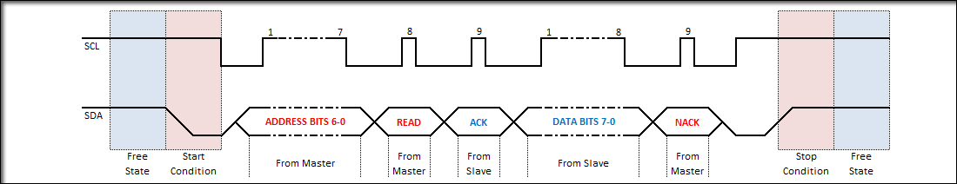

I2C wave form
Master
SCL
SDA
Slave 1
Address: 0x20
Slave 1
Address: 0x38

Slide 20
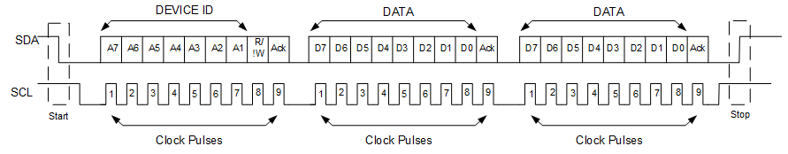
I2C multiple Read\Write
No stop bit

Slide 21
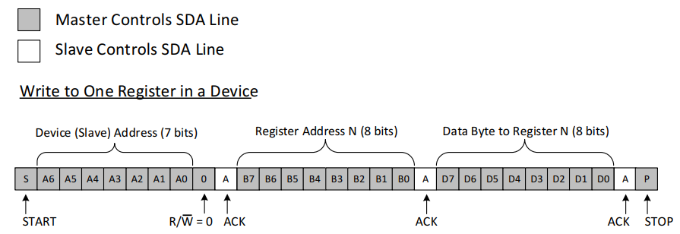
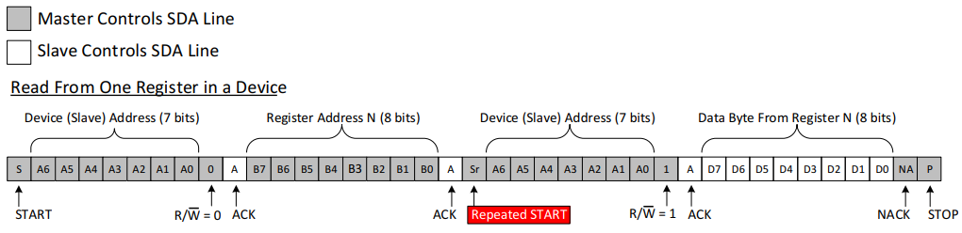

Slide 22
I2C Code example
// Setup
Wire.begin(-1/*Native SCL Pin*/, -1/* Native SDA Pin*/, 100000); // Arduino Wire.begin is different!
// Read
Wire.requestFrom(address,(uint8_t)1/*Size*/);
if(Wire.available()) // If bytes are available to be received
{
unsigned char dataIn = Wire.read();
}
// Write
Wire.beginTransmission(address);
Wire.write(data);
Wire.endTransmission();
Wire1.endTransmission(false); // For repeated start

Slide 23
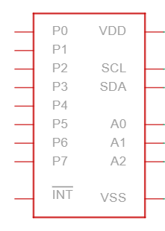
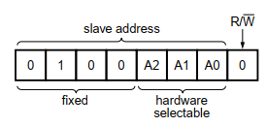
I2C I/O expander - PCF8574/A
8 I/Os expander via I2C interface, address: 0x20 or 0x38 (A)
3 bits to control less significant part of the I2C address to enable up to 16 devices on the same bus (8 PCF8574 and 8 PCF8574A)
Exists in Tinker cad ☺ (Address 0x20) with NO driver!!, for the ESP32 we do have a driver

Slide 24
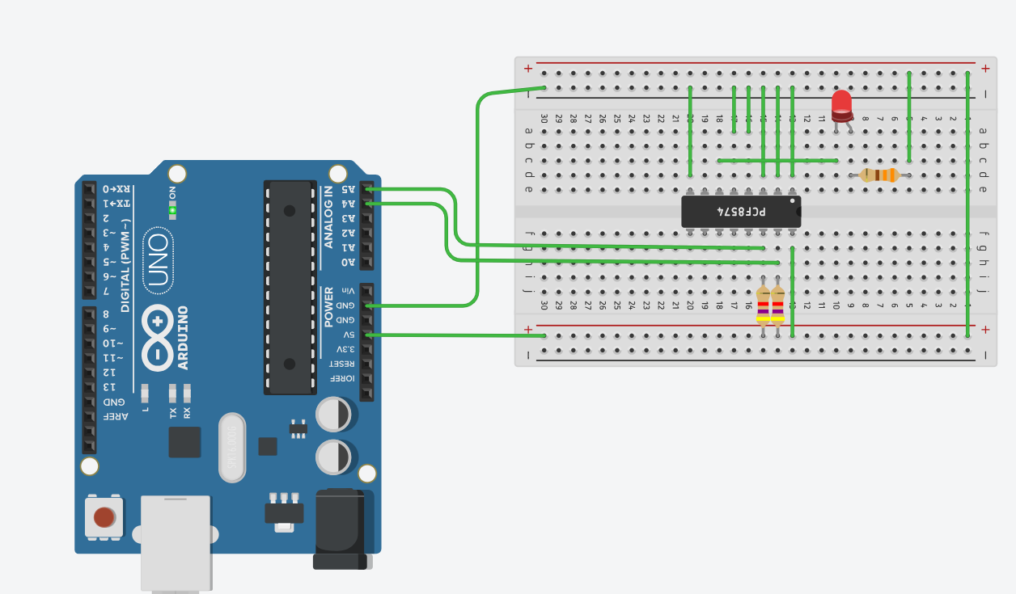

Slide 25
Code (For ESP32 with a driver from our GIT):
#include "PCF8574.h"
PCF8574 pcf8574(0x20); // Use 0x38 for the A type
void setup()
{
Serial.begin(115200);
// void begin(bool callWireBegin = true, bool useWire1 = false);
pcf8574.begin();
pcf8574.pinMode(P0, OUTPUT); // SD CS
pcf8574.digitalWrite(P0, HIGH);
}
void loop()
{
unsigned int input = pcf8574.digitalRead(P0);

Slide 26
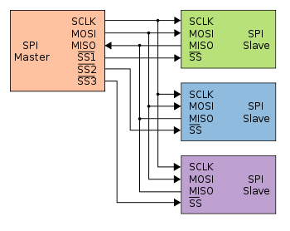
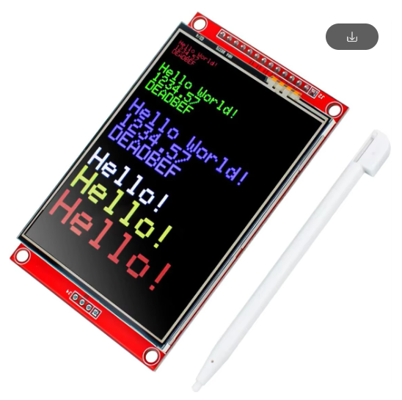
SPI - Serial Peripheral Interface
Much higher performance than UART or I2C
1 bit data (MOSI, MISO, CLOCK, CS)
Master Out Slave In
Master In Slave Out
4 or 8 bits data (CLOCK, CS, bi-directional D0-D7)
Bus topology – using chip select to address a specific device
Master and slave methodology
Up to 166MHz (DDR)
Mostly used for flash memories, SD cards, simple LCDs, LoRa transmitters and more

Slide 27
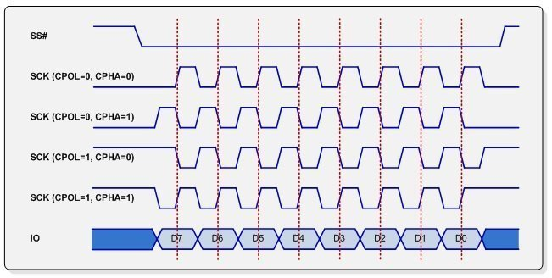
SPI Working modes
SPI mode | Clock polarity (CPOL/CKP) | Clock phase (CPHA)
0 | 0 | 0
1 | 0 | 1
2 | 1 | 0
3 | 1 | 1
CPOL - Clock polarity
CPHA - Clock phase
Meant for better timing setup

Slide 28
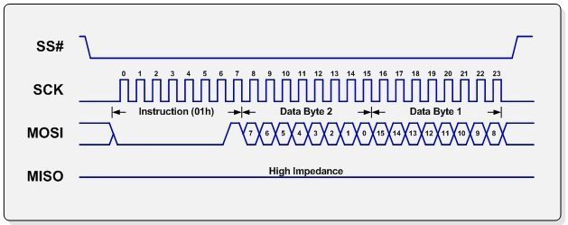
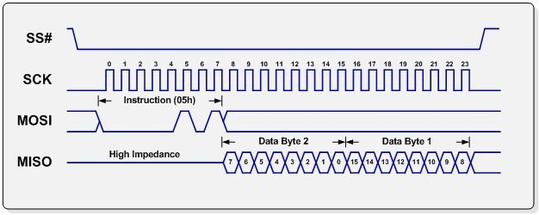
Read\Write (From flash memory) – 1 bit
Dummy cycles
Are optional

Slide 29
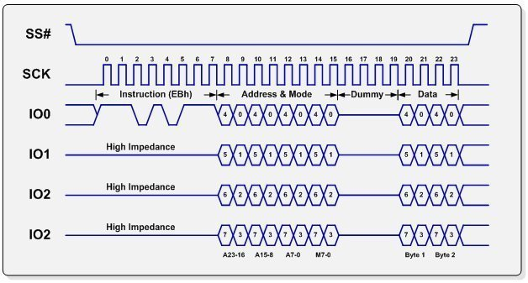
Read\Write (From flash memory) – 4 bit
Dummy cycles to enable
I/O direction change

Slide 30
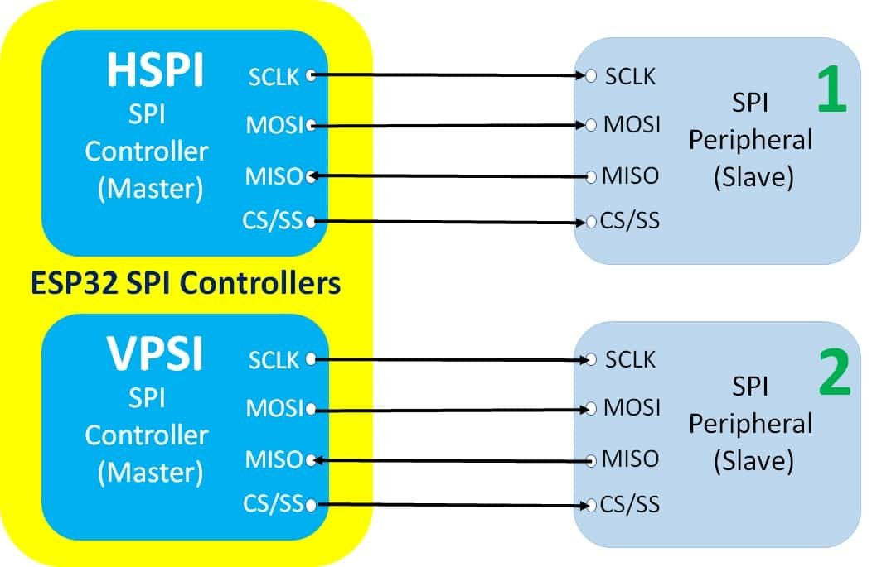
SPI in our code (ESP32 has 2 units)
Setup:
begin(int8_t sck=-1, int8_t miso=-1, int8_t mosi=-1, int8_t ss=-1);
SPI.begin(18, 19, 23, 5);
SPI.setBitOrder(MSBFIRST);
SPI.setFrequency(10000000L);
SPI.setDataMode(SPI_MODE3);

Slide 31
Write data:
SPI.beginTransaction(SPISettings(10000000, MSBFIRST, SPI_MODE0));
digitalWrite(spi->pinSS(), LOW); //pull SS slow to prep other end for transfer
SPI.transfer(data);
digitalWrite(spi->pinSS(), HIGH); //pull ss high to signify end of data transfer
SPI.endTransaction();
Or:
SPI.write

Slide 32
Read Data – Too complex for this stage ☺

Slide 33
ESP32’s Communication ports units
3 UARTs (first is the main and used for communication with the user and uploading code)
Up to 5 MHz
Can be mapped on almost any I/O
3 SPI (first used for main flash and PSRAM and is 4 bit wide)
Up to 80 MHz
1\8 Bit wide
Can be mapped on almost any I/O
2 I2C
I2S – Audio dedicated protocol
Also used along with GPIO and DAC to generate very interesting projects

Slide 34
Available accessories/peripherals/devices
Sensors: Motion, distance, temperature, color, light, smoke, gas, humidity and more
Input: Potentiometers, simple on\off buttons, touch devices, analog joy sticks and more
Displays: LCD and LED matrix
Storage: Flash memory, SD cards, I2C EEPROM
Servo and DC motors
Physical and solid state relays
Infrared transmitters and receivers
RF based I/O and LoRa
Battery chargers
RTC (Real time clock)
GPS, Gyro, accelerometers
3G modem with SIM card supporting calls and SMS send\receive
Fingerprint sensor
Just search the web and you will be amazed by what is out there!

Slide 35
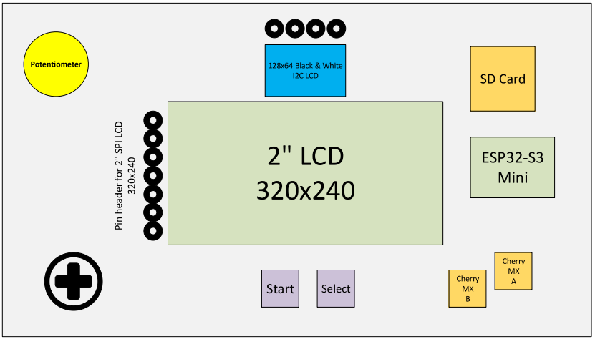
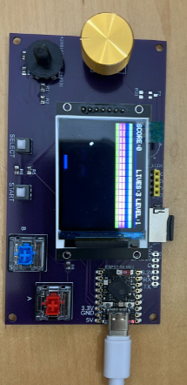
Our future course platform

Slide 36
Getting started …

Slide 37
What to watch out when selecting a device?
Communication protocol used by the device
If we have a free interface resource (SPI, UART and Etc.)
Cost
Software driver availability
Communication channel is compatible with our MCU and has no BW limitations
Voltage levels are compatible
Make sure I/Os we have chosen are not dedicated for boot strap options of the MCU
ESP32:
IO12 must not be pulled up, do not use as input!
IO2 – If pulled high will block loading new sketch
When using I2C devices: check there is no address conflict
Are there signals which requires a pull up \ down (in most cases open drain)

